Slide 1


Precepting
Dietetic
Internship

Slide 2

Accreditation
Dietetic Internship Program
The KU-DI is granted candidacy status by the Accreditation Council for Education in Nutrition and Dietetics (ACEND), 120 Riverside Plaza Suite 2000, Chicago, IL 60606-6995, 1-800-877-1600.
The program is comprised of a 5-day orientation, 15 weeks of community nutrition, 16 weeks of Medical Nutrition Therapy, and 4 weeks of food service systems/dietetic management. Interns will complete 1320 hours of supervised practice.

Slide 3
Accreditation
Dietetic Internship Program
Keiser University is accredited by the Southern Association of Colleges and Schools Commission on colleges to award certificates and degrees at the associate, baccalaureate, masters, specialist, and doctoral levels.
Contact the Commission on Colleges at 1866 Southern Lane, Decatur, GA 30033-4097 or telephone 404-679-4500 for questions about accreditation of Keiser University

Slide 4
Supervised Practice
Keiser University Graduate Dietetic Internship is a distance program with an emphasis concentration of Community. Potential interns locate their own preceptors in their own geographic area. Potential interns must complete:
Concentration | Hours
Acute care – LTC | 640
Community | 520
Food Service Systems/ Dietetic Management | 160
Total of hours to be completed are 1320

Slide 5
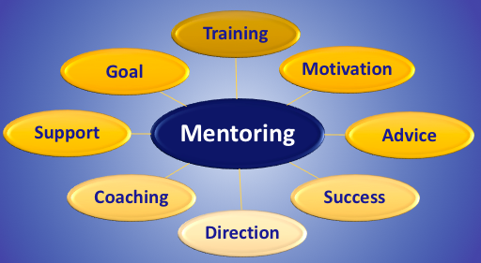
Mentoring experience
Volunteering to give personal instruction, training, teaching ,supervision, coaching, role model, orienting to work environment, feedback.

Slide 6

What is precepting?
The goal is to prepare interns for future dietetic practice. The intern is learning technical dietetic skills as well as professional behavior skills. Preceptors are the role-model for the intern. Below is an example of what coaching and mentoring is and what coaching and mentoring is not.

Slide 7
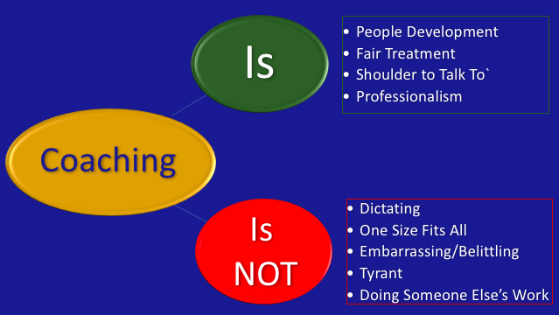
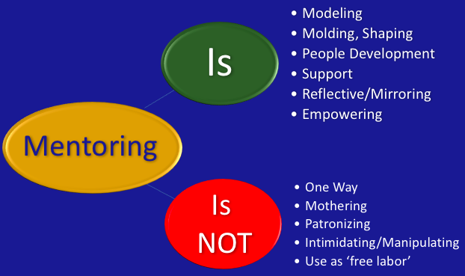
Precepting

Slide 8



Precepting
Registered Dietitians and other professional practitioners as Preceptors give of their:
In areas of Retail, Sports, Eating Disorders, Dialysis, Medical Nutrition Therapy (MNT), Long-term care, Food Service Systems/Dietetic Management, Public health/Community

Slide 9
Role of Preceptor
Preceptors have mastered their practice and are dedicated professionals for the advancement of the profession. Preceptors provide the opportunity to share your expertise and enthusiasm for his or her area of expertise.
Meeting regularly with your intern both formally and informally
Guiding your intern through the daily operations of the program/facility
Arranging for your intern to interact with other disciplines and other departments
Observing your intern’s professional style and behavior at the site

Slide 10
Role of Preceptor
Providing your intern feedback for technical and professional growth
Listening to your intern
Modeling and providing time management techniques
Serve as a teacher providing knowledge, guidance and support
Demonstrate effective interpersonal and communication skills
Sensitive to the learning needs of the intern
Provide feedback effectively to interns and/or to the program director/program coordinator
Serve as a facilitator helping the intern meet personal and course objectives
Nurturer the intern providing support and guidance
Resource to guide the intern to appropriate sources for learning
Monitor how the intern manages their time without “patrolling”
Introduce the intern to the culture, politics and rules of the organization/agency
Intern is not considered “free labor”

Slide 11
Role of Intern
Give Respect to all dietitians, facility employees, patients and visitors
Interns will be expected to:
Wash your hands before entering all patient rooms.
Ask preceptor or manager questions related to learning food service.
“Look-up” answers and further discuss answers with preceptor or manager.
Avoid texting and/or personal cell phone usage and/or internet usage not patient related.

Slide 12
Role of Intern
Be self-motivated, self-disciplined and responsible for your OWN learning
Listen to preceptor(s) and take direction from him/her
Intern respects patient and/or departmental confidentiality at all times
Some facilities may have more than one campus during the internship – you may have to travel between campuses (possibly on the same day)
Intern schedule subject to change often depending on the facilities needs
May have to put in more than 8 hours days at times
May be expected to help with catering, doctor’s dining, medical executive meeting – intern may have to work an evening event
May need to give up a computer to manager or supervisor graciously
Welcome to attend any in-services or continuing education meeting (permission of CNM or preceptor)
Contact preceptor or food service director or manager of any absences or tardiness before the start of the work shift.

Slide 13
Role of Intern
Intern will work the hours of the manager or supervisor or subsystem of the kitchen assigned
Intern will notify PD/CC of absences or tardiness before the start of the work shift
Notify preceptor or food service director or manager arrival at facility and leaving the facility for day
Intern must gain permission from preceptor or food service director or manager to leave the facility during the shift
Intern will coordinate with preceptor and gain approval of PD/CC to make-up any missed hours
Intern’s do not do homework assignments during rotations – may gather information for Performance Improvement or other projects assigned by preceptor

Slide 14

Preceptor Handbook
The Preceptor handbooks share the types of assignments the intern will complete during the rotation. Assignments can be modified still meeting the
assigned ACEND
competencies for the
assignment.
Handbook clearly presents
the Keiser mission and the
mission of the of the distance learning internship.

Slide 15
Affiliation Agreement
Keiser University Graduate School Affiliation Agreement.
The Keiser University Graduate School Affiliation agreement must be fully executed before the intern can begin the rotation. Keiser University will gladly work with your organizations affiliation agreement.
Interns will be required to meet the requirements of the facility before beginning the rotation.

Slide 16
Affiliation Agreement
For MNT and other rotations providing nutrition education/counseling, Keiser University provides the medical malpractice insurance for the intern.
A Keiser University Certificate of Liability can be issued.

Slide 17
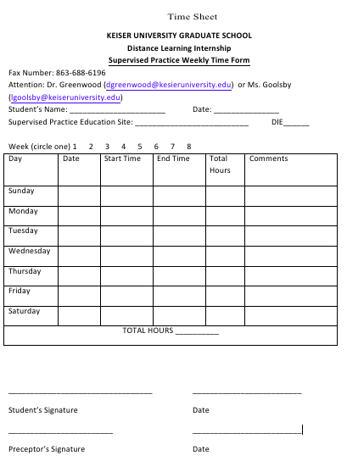
Time Sheet
Preceptors are asked to sign the intern’s weekly time sheet. Listed on the second page are a listing of potential meetings the intern can observe and participate. Please indicate the meeting.

Slide 18
CDR Preceptor Training
The Commission on Dietetic Registration (CDR) has developed an online Dietetics Preceptor Training Course. The course is a series of modules offering the preceptors guidance throughout the precepting process. The preceptor can receive 8 Continuing Professional Education (CPE) at no cost. The CDR website for the training course:
https://www.cdrnet.org/news/online-dietetics-preceptor-training-course-free-of-charge

Slide 19
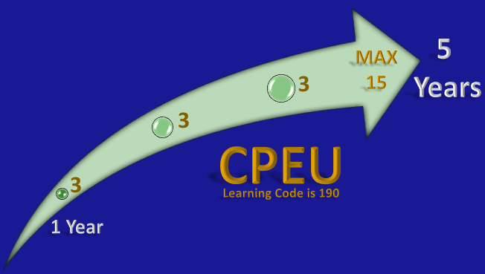
Continuing Professional Units
Effective June 2017, the Commission on Dietetic Registration (CDR) has granted Continuing Professional Education Units (CPEU) for precepting interns from an ACEND accredited internship. CDR has authorized 3 CPEUs per year for precepting an intern.
Precepting CPEU forms are located on the Commission for Dietetic Registration website (https://www.cdrnet.org/cpeu-credit-for-preceptors). Complete the forms, email forms to program director for signature.

Slide 20

Contact information
Program Director
Dona Greenwood, PhD, RDN, LDN, FAND
dgreenwood@keiseruniversity.edu
Clinical Coordinator
Laura Goolsby, MS, RDN, LDN
lgoolsby@keiseruniversity.edu

Slide 21
Thank You
On behalf of the Keiser University Graduate School, Distance Learning Internship team, we would like to express our appreciation for giving of your time and expertise to mentor the intern through this internship rotation. Your dedication to nutrition and dietetics will assist the intern in gaining the knowledge and skills necessary for entry-level practice.

